Slide 1

Consumer Behavior Analysis
University of New Hampshire
Peter T. Paul College of Business and Economics
Unstructured Data
Aleena Linson, Dagny Wilkins, Drew Rigney
Notes:
Aleena

Slide 2
Agenda
Data Overview
Exploratory Data Analysis
Hierarchical Clustering
Mixture Model
Deep Learning
Conclusion
Notes:
Aleena

Slide 3
Consumer Behavior Data
Year of Birth
Education
Marital Status
Date of First Purchase
Accepted Promotions
Customer Complaints
# of Children
# of Teens
Income ($)
Purchase Recency
Amount Spent
Number of Purchases
Notes:
Dagny
Around 2200 rows of data

Slide 4
Data Transformation
Year of Birth → Current Year – Year of Birth = Age
Date of First Purchase → Current Date – Date of First Purchase = Number of Days Customer For
Notes:
Dagny

Slide 5
Exploratory Data Analysis
24 null values in the Income column
Outliers present in the Age, Income, Purchases, and Amount Spent
Moderate to high correlation among certain features
Notes:
Drew

Slide 6
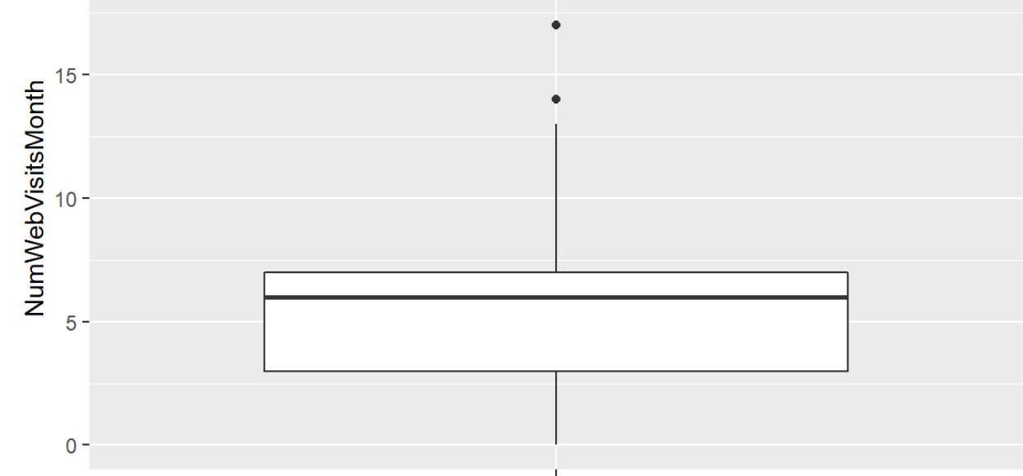
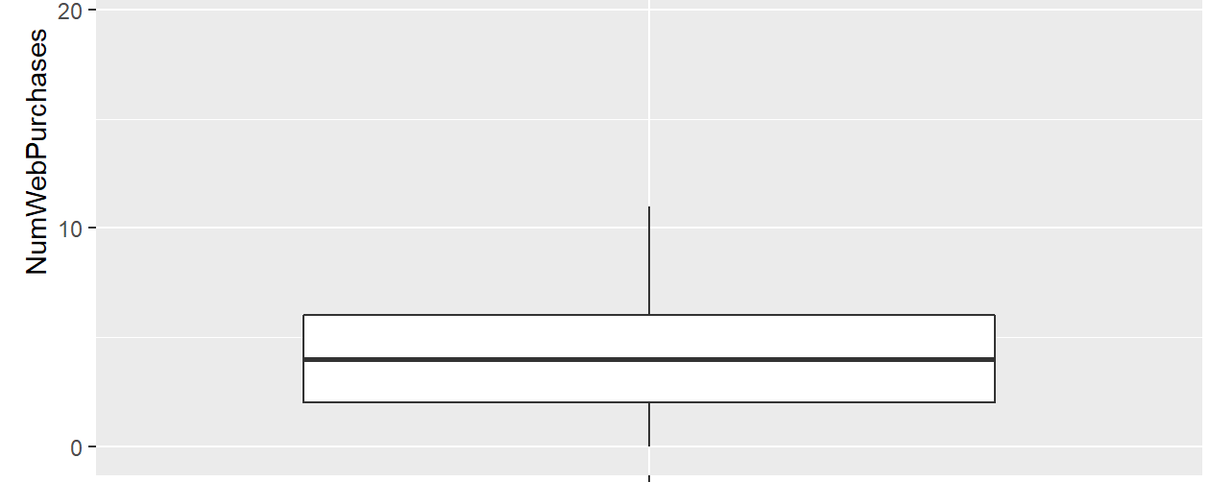
Exploratory Data Analysis
Web visits and web purchases are related and have a similar median value.
Number of Web Visits per Month
Number of Web Purchases per Month
Notes:
Drew

Slide 7
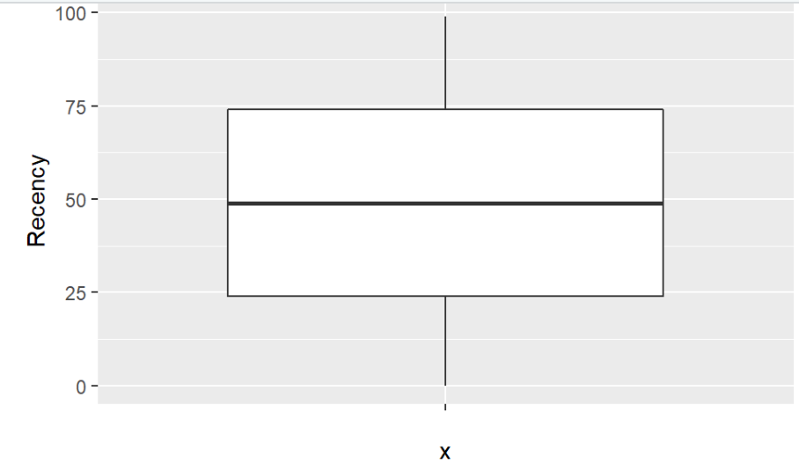
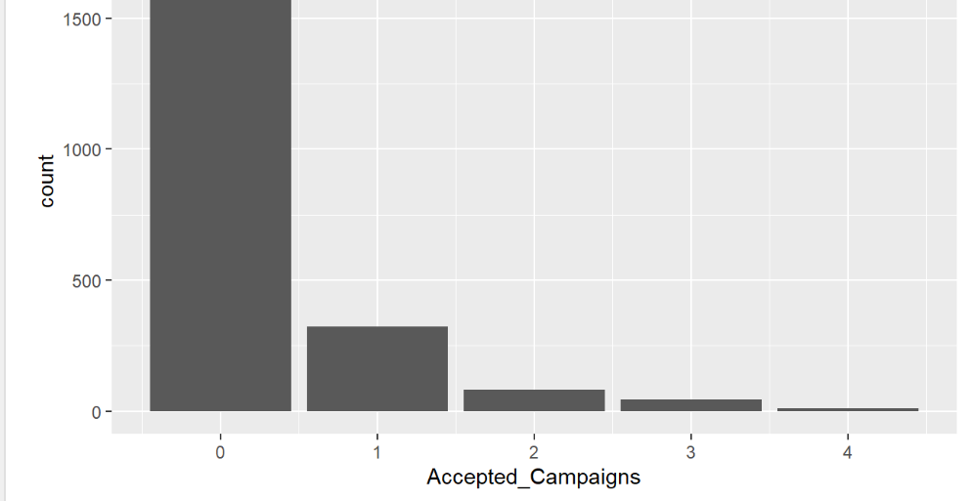
Exploratory Data Analysis
Number of Days Since Last Purchase
Distribution of Accepted Campaigns
Notes:
Drew

Slide 8
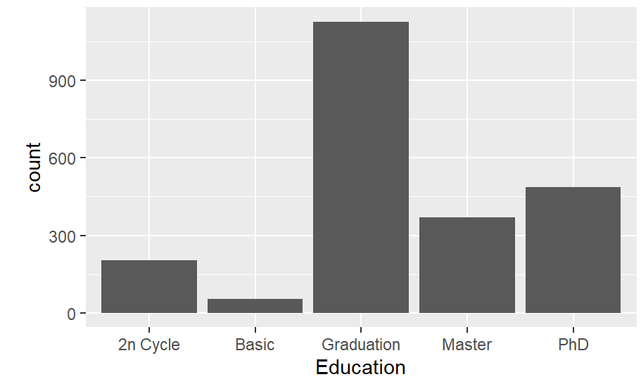
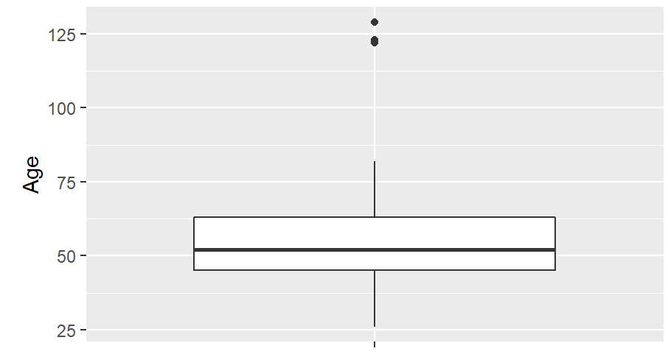
Exploratory Data Analysis
Education Levels among Customers
Age Distribution
Notes:
Drew

Slide 9
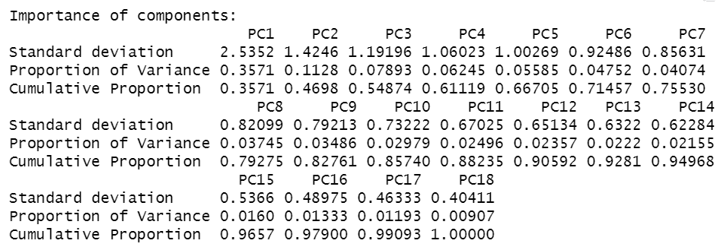
PCA and Scaling
10 components is significant
Notes:
Dagny
Scaling the data was necessary since the variables had a wide range of scales, and the team will be using distance based algorithms. This will ensure that all the features contribute equally to the result and that the larger numbers (ie Income) aren't overpowering. Additionally, we also need dimension reduction. There seems to be some strong to moderate correlations between some of the variables, so conducting a principle components analysis on scaled data will help alleviate all of these concerns. For this analysis, 10 principle components is sufficient since it accounts for about 85% of the variation. This reduced the number of features needed in this analysis by eight. The dimension reduction was successful.

Slide 10
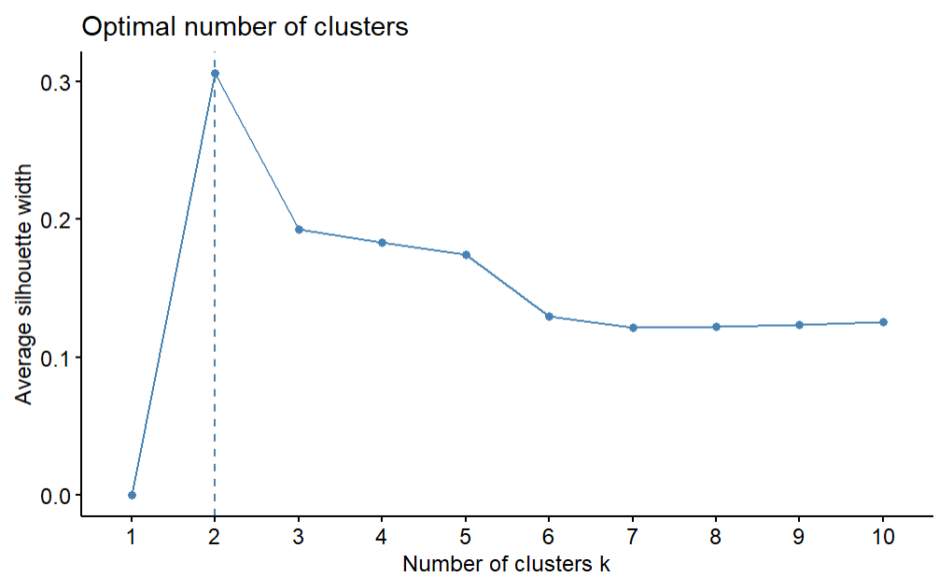
Hierarchical Clustering
Optimal number of clusters is two
Cluster 1 | Cluster 2
2208 | 4
Notes:
Dagny
Used complete and silhouette method

Slide 11
Hierarchical Clustering
Four clusters is more realistic
Better distribution of data
Cluster 1 | Cluster 2 | Cluster 3 | Cluster 4
548 | 1643 | 17 | 4
Notes:
Dagny

Slide 12
Mixture Model
Optimal number of clusters is nine
Cluster 1 | Cluster 2 | Cluster 3 | Cluster 4 | Cluster 5 | Cluster 6 | Cluster 7 | Cluster 8 | Cluster 9
253 | 423 | 151 | 113 | 175 | 389 | 224 | 66 | 418
Notes:
Dagny

Slide 13
Mixture Model
Four clusters provides the lowest BIC score
Cluster 1 | Cluster 2 | Cluster 3 | Cluster 4
579 | 832 | 450 | 351
Notes:
Dagny

Slide 14
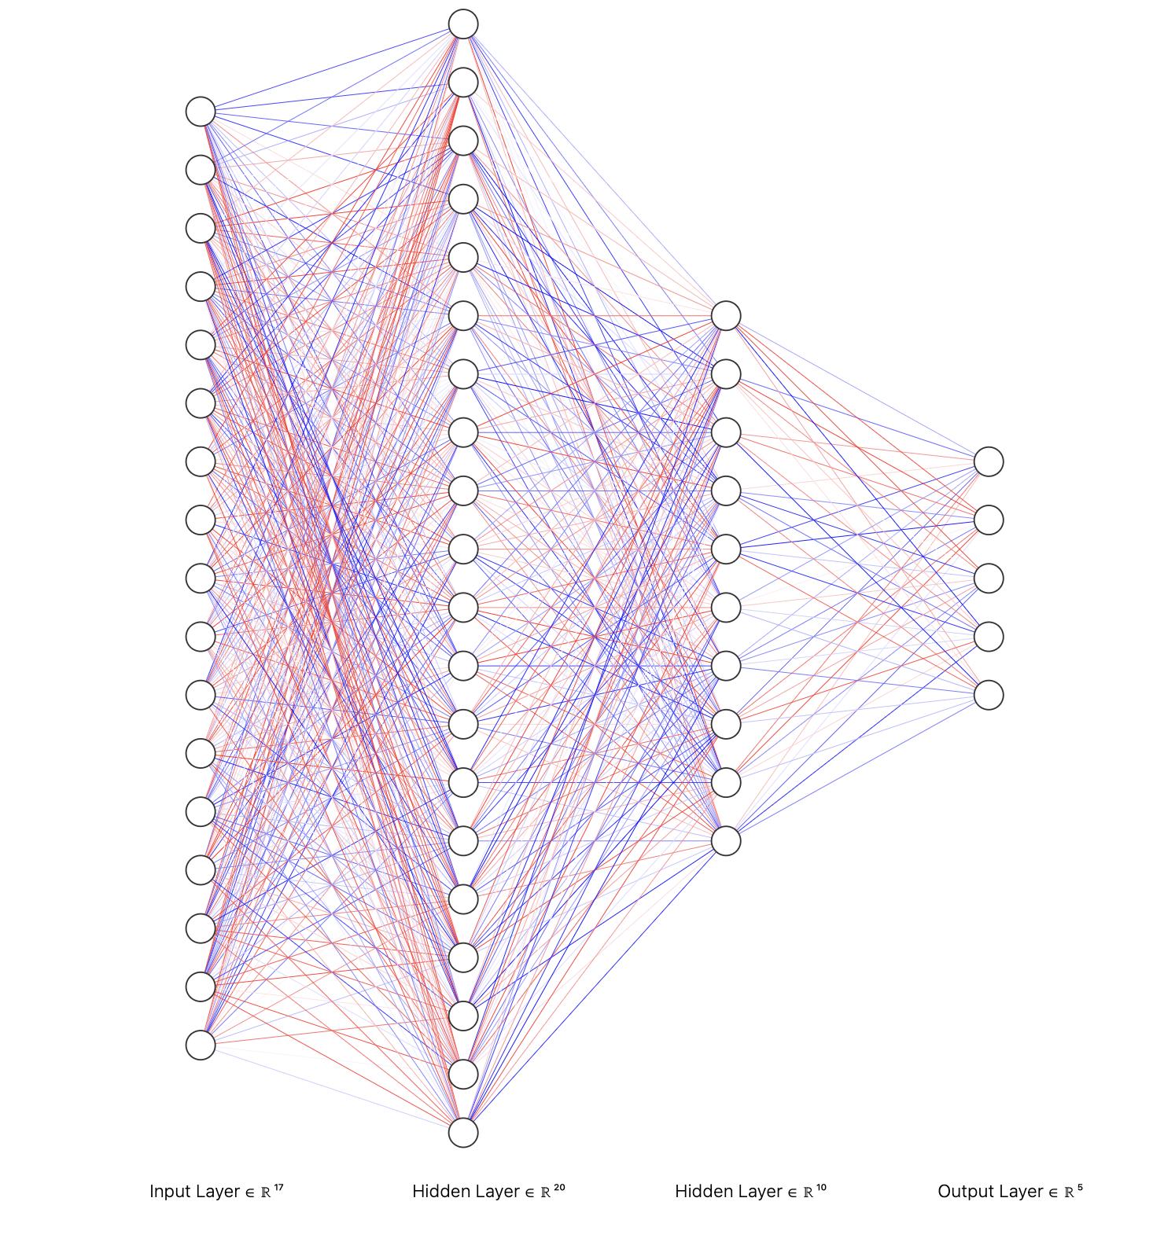
Deep Learning Model (FFNN)
'relu'
'relu'
'softmax'
FFNN
RNN
CNN
Notes:
Aleena

Slide 15


Deep Learning Model
Before hyperparameter tuning
After hyperparameter tuning
Accuracy​ | Loss​
0.8088012 | 0.6735640
Accuracy | Loss
0.8172 | 0.4825
Notes:
Aleena

Slide 16
Conclusion
Four is the optimal number of clusters
Neural Network classification can help determine how many campaigns a customer will accept
This analysis is a starting point
Can use clusters to understand different market segments/develop marketing strategies
Notes:
Drew

Slide 17
Learning Outcomes
How to fit a FFNN and perform deep learning classification
How to choose most appropriate clustering algorithms and explain the choice to a technical audience
How to use Exploratory Data Analysis to inform the rest of the analysis
How to think outside the box to still incorporate categorical variables in an effective manner
Notes:
Drew

Slide 18
Questions?
Thanks for listening!
Notes:
Drew

